Slide 1

MERN Setup
Quick Guide to Setup Your MERN Project
yourwebsite.com
→

Slide 2
Introduction
→
In this presentation, well walk through setting up your MERN development environment from scratch on Windows. Youll learn how to organize project folders, install Node.js and MongoDB, and troubleshoot common installation issues. Well also cover running the backend and frontend servers to get your project up and running smoothly.

Slide 3
Topics Covered
Installation of tools for MERN development
Verifying error free installation and troubleshooting with fixes
Setting the development environment and folder structure
Learning how to use Mongodb Compass to insert records in database
Programming Express backend to communicate with backend and perform CRUD operations
Building Frontend Interface to control backend and manipulate database using forms and buttons

Slide 4
What is MERN Stack ?
Consider a builders a toolbox , it wil have various tools like hammer, spanner, saw, screwdriver etc
Similarly, MERN stack is a bundle of tools (toolbox), where each letter corresponds to a
single tool with a specialized purpose

Slide 5
What is MERN Stack ?
M
Stands for Mongo Database
E
Stands for Express Backend
R
Stands for React Frontend
N
Stands for Node Environment & Package Manager

Slide 6
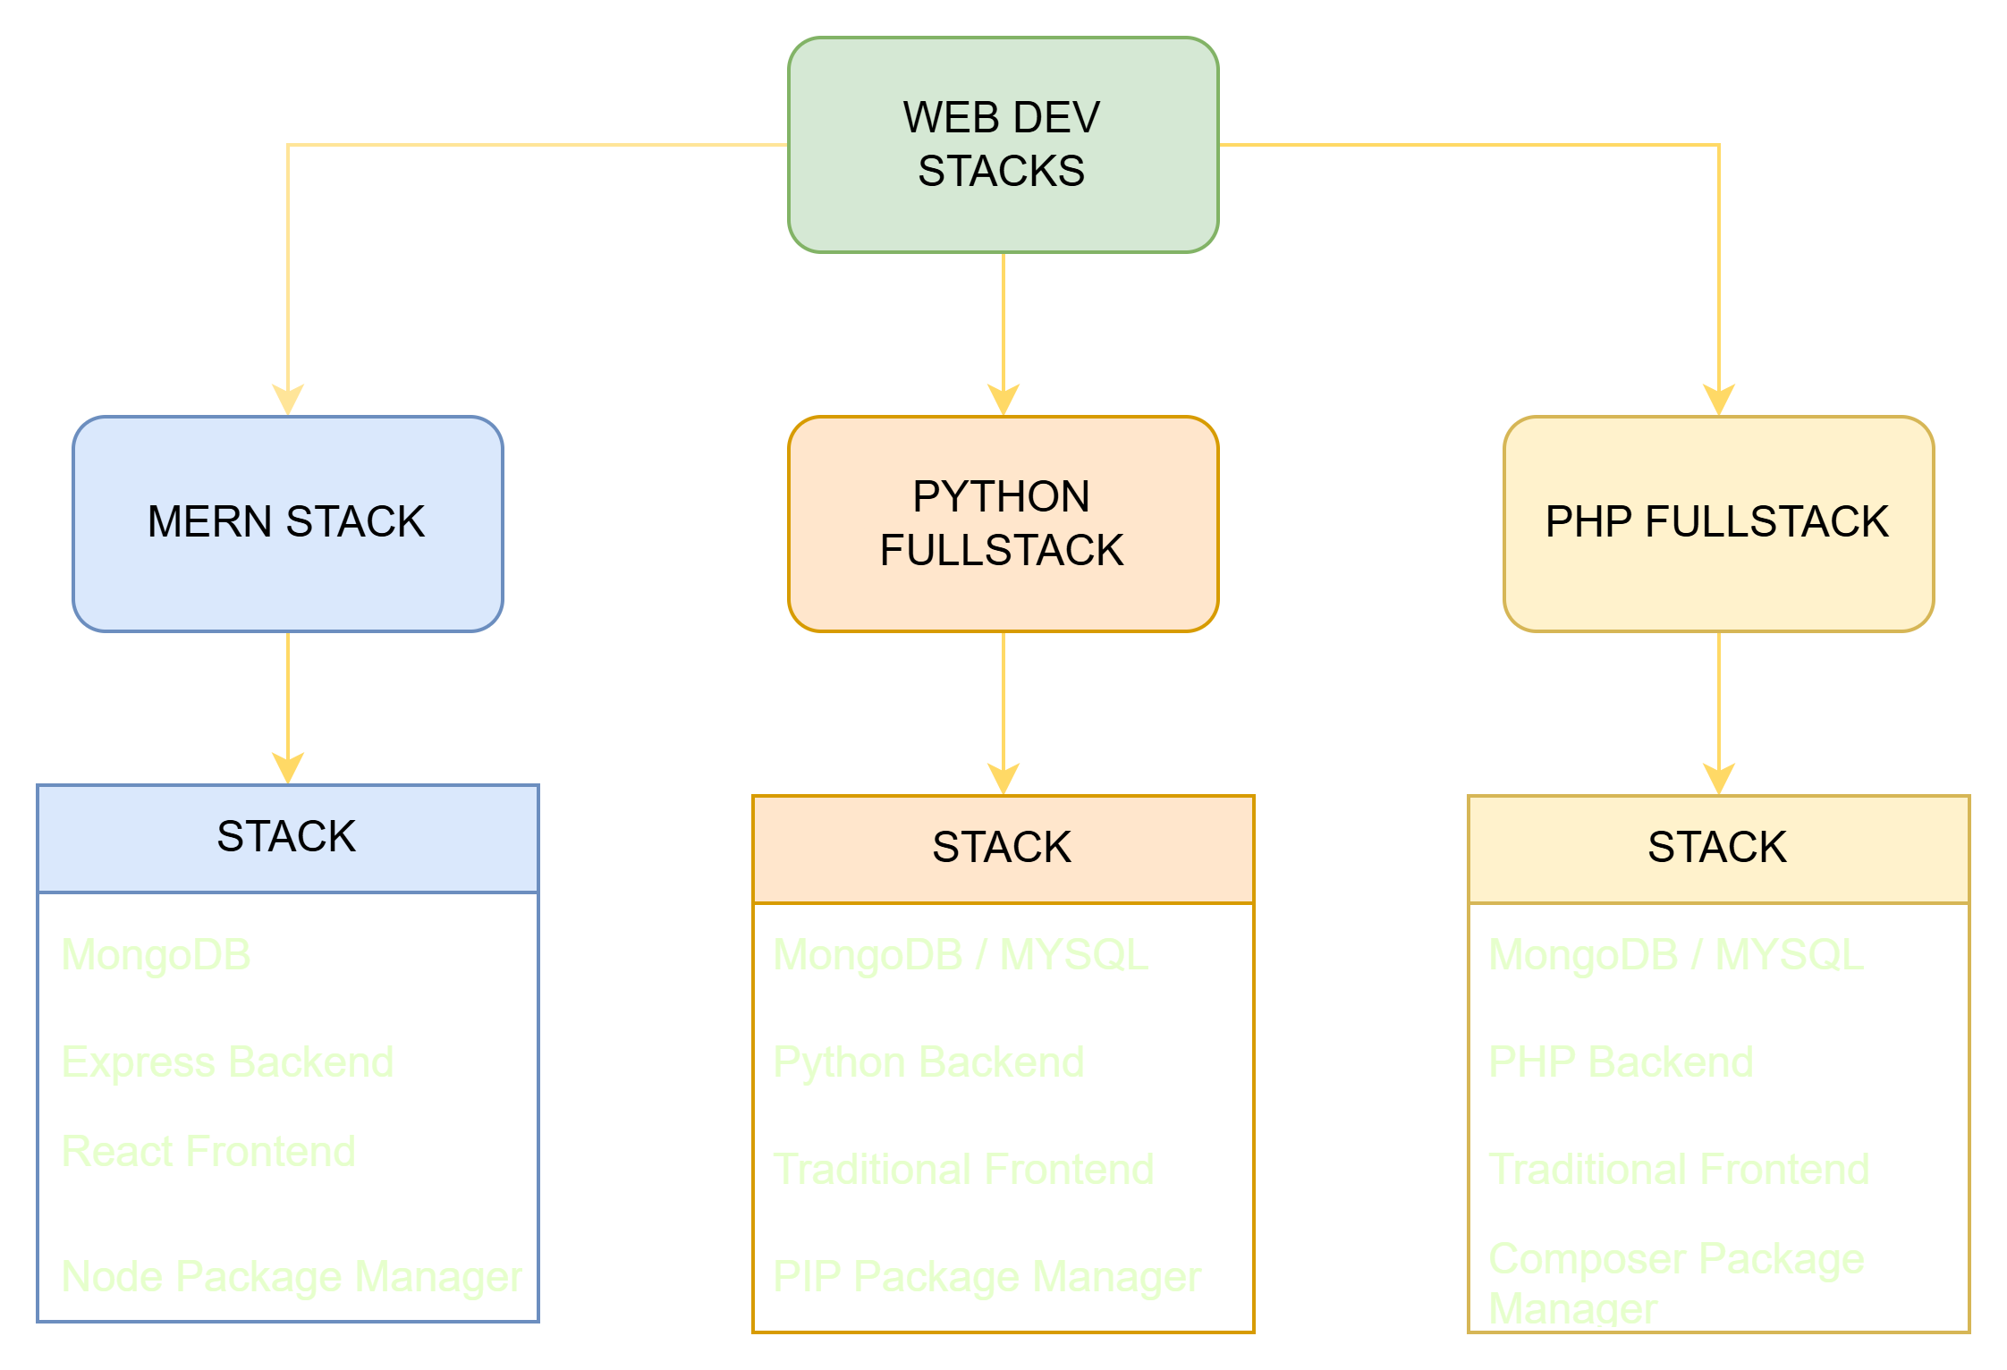
Full Stack Path Choices

Slide 7

MERN Setup Prerequisites
Install node js from nodejs.org
Install mongodb community edition
Install mongodb compass

Slide 8
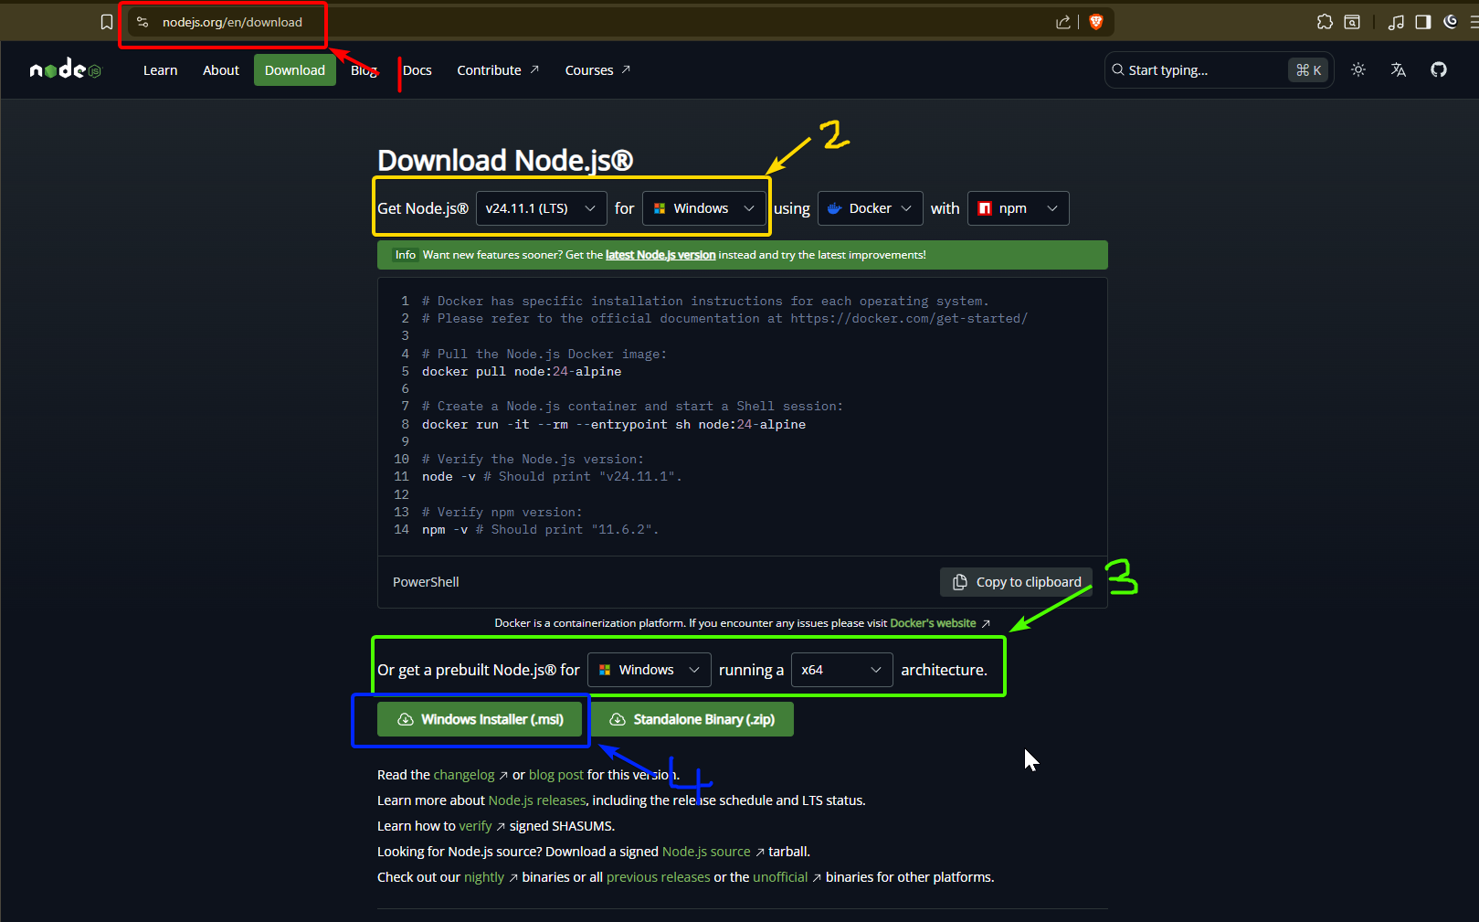

Slide 9
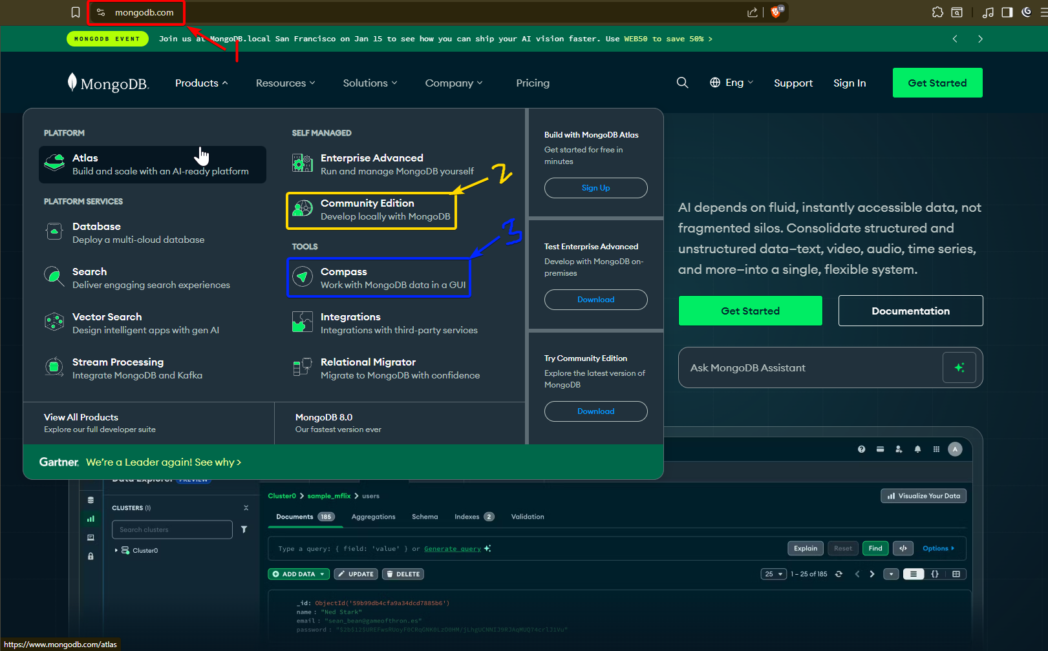

Slide 10
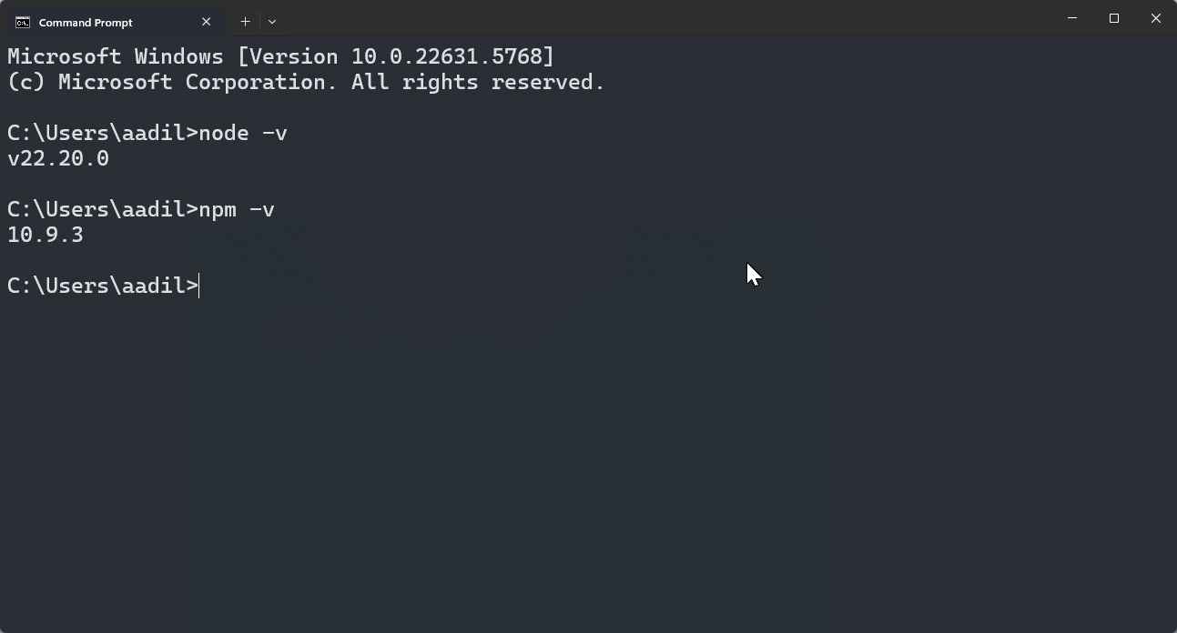
Checking NodeJS Installated Correctly

Slide 11
Node.js, npm, and MongoDB Installation Fixes
→
Sometimes npm scripts are blocked by PowerShell, or npm and Node.js commands fail due to missing folders or PATH misconfiguration. Fix these by adjusting execution policies, creating necessary folders, and adding Node.js paths to your system environment variables. Confirm installation success by running node -v and npm -v commands.

Slide 12
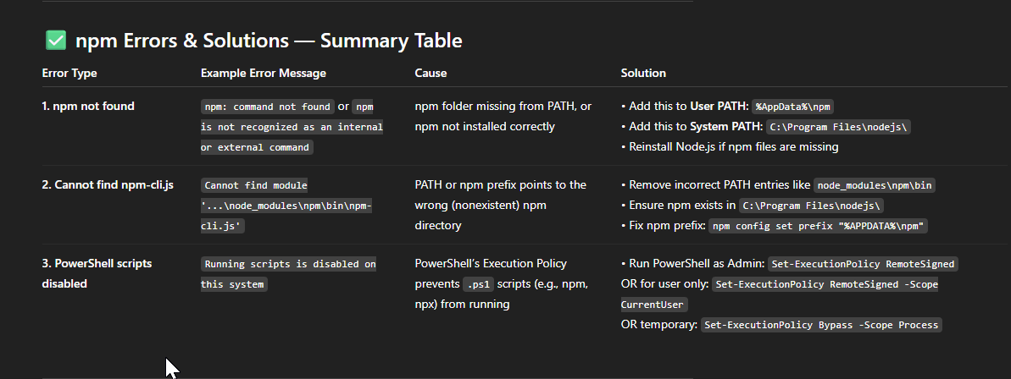

Slide 13
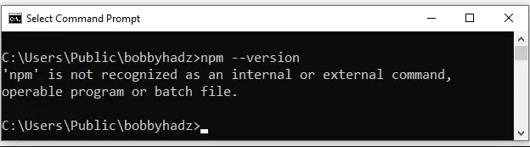
Error 1: npm not found or recognised

Slide 14
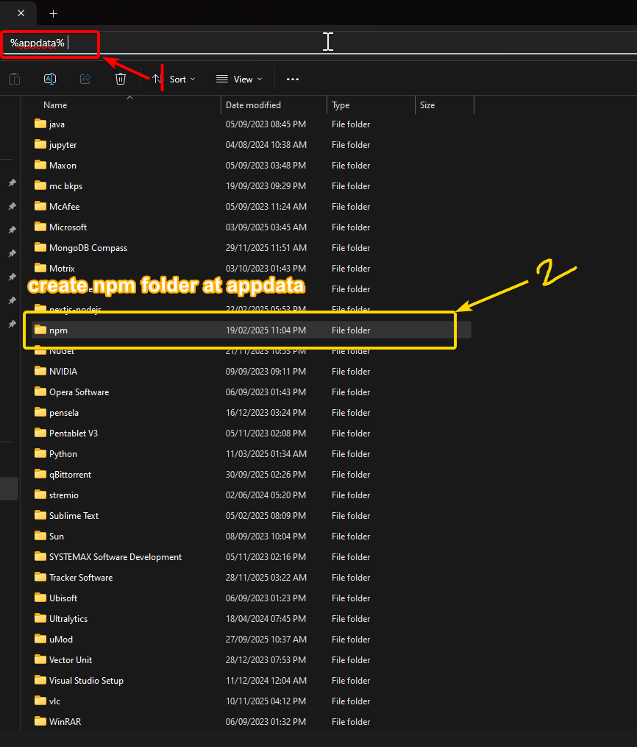

Slide 15
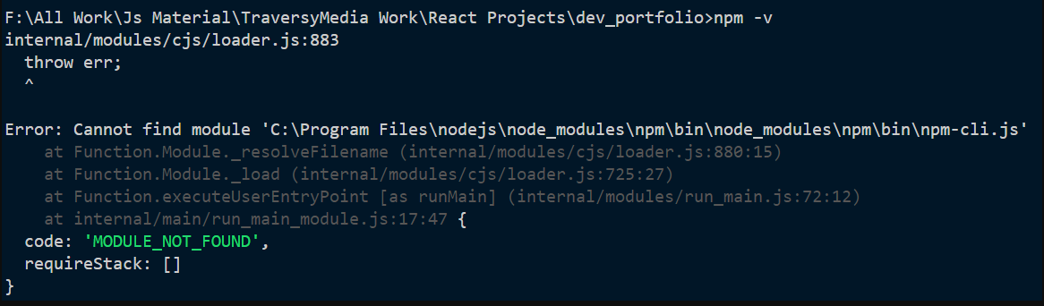

Slide 16
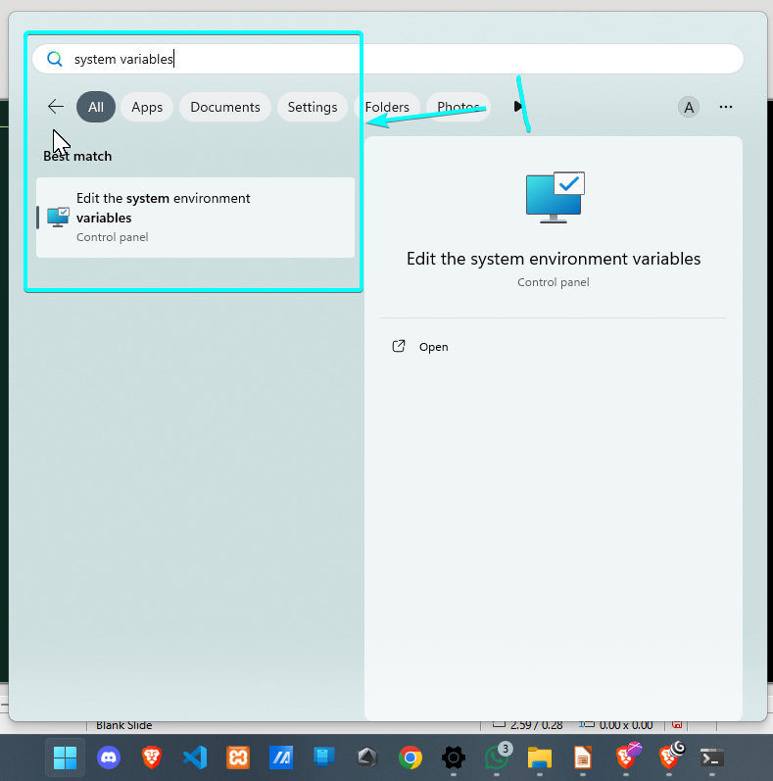

Slide 17
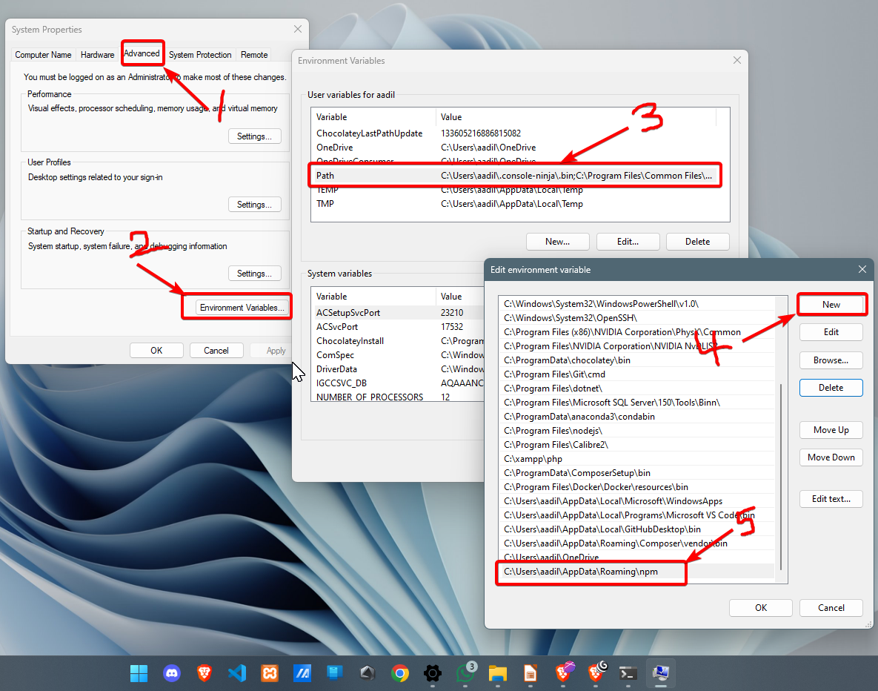

Slide 18
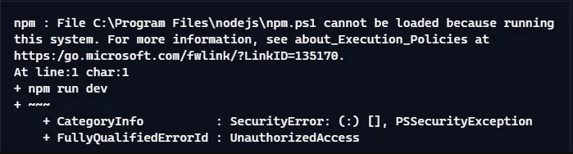

Slide 19
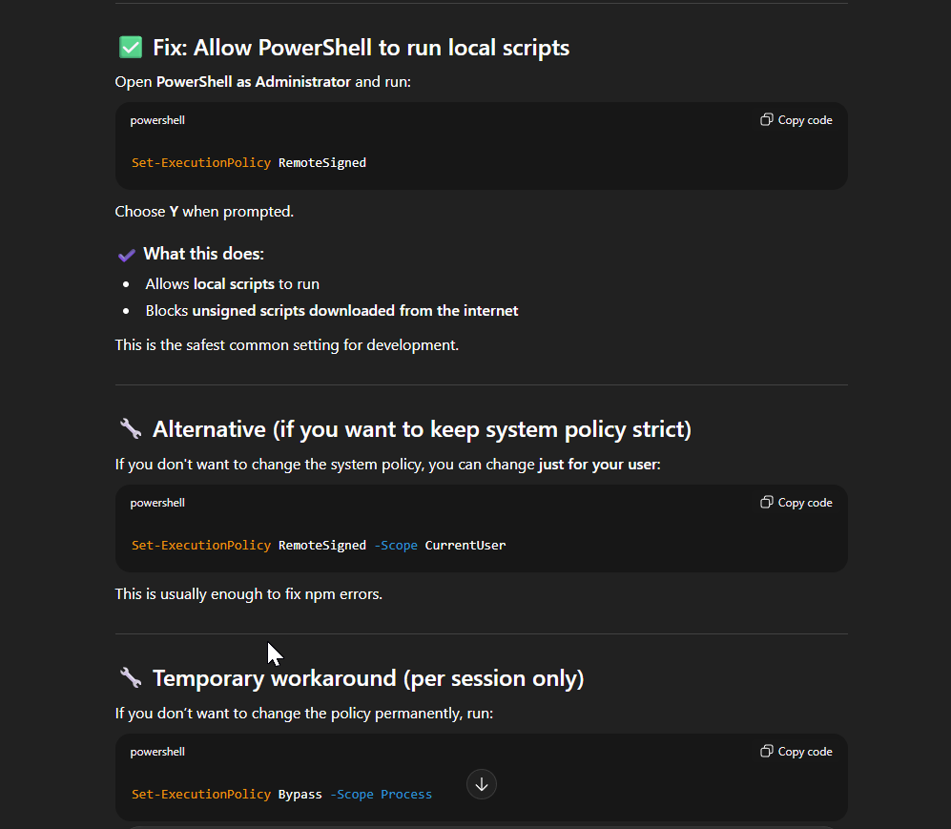

Slide 20
Windows Setup and Folder Structure
→
Start by creating a main project folder, for example, LearnMERN, on your drive for ex: Z: . Open Command Prompt within this folder by typing cmd in File Explorers address bar. Use a single-line command to create backend and frontend subfolders, initialize backend with package.json, install dependencies, and prepare scripts to run both servers efficiently.

Slide 21
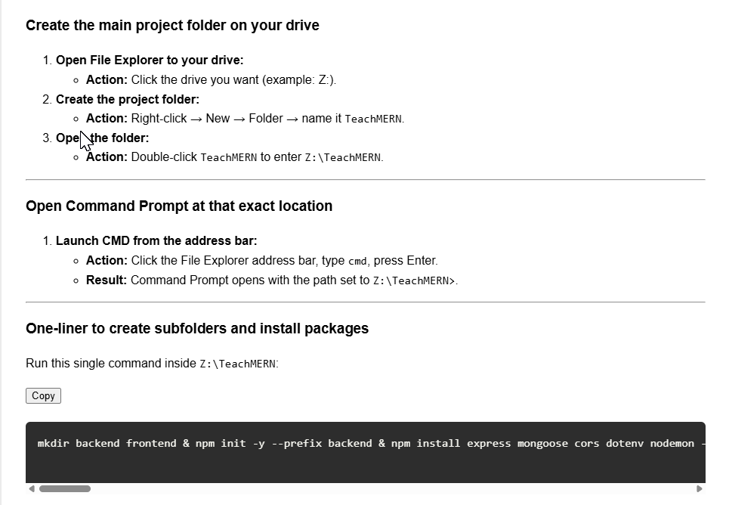
Goto: https://aadilmohammed360.github.io/Learn-MERN-Fundamentals/
Copy my one liner command from chapter 1

Slide 22
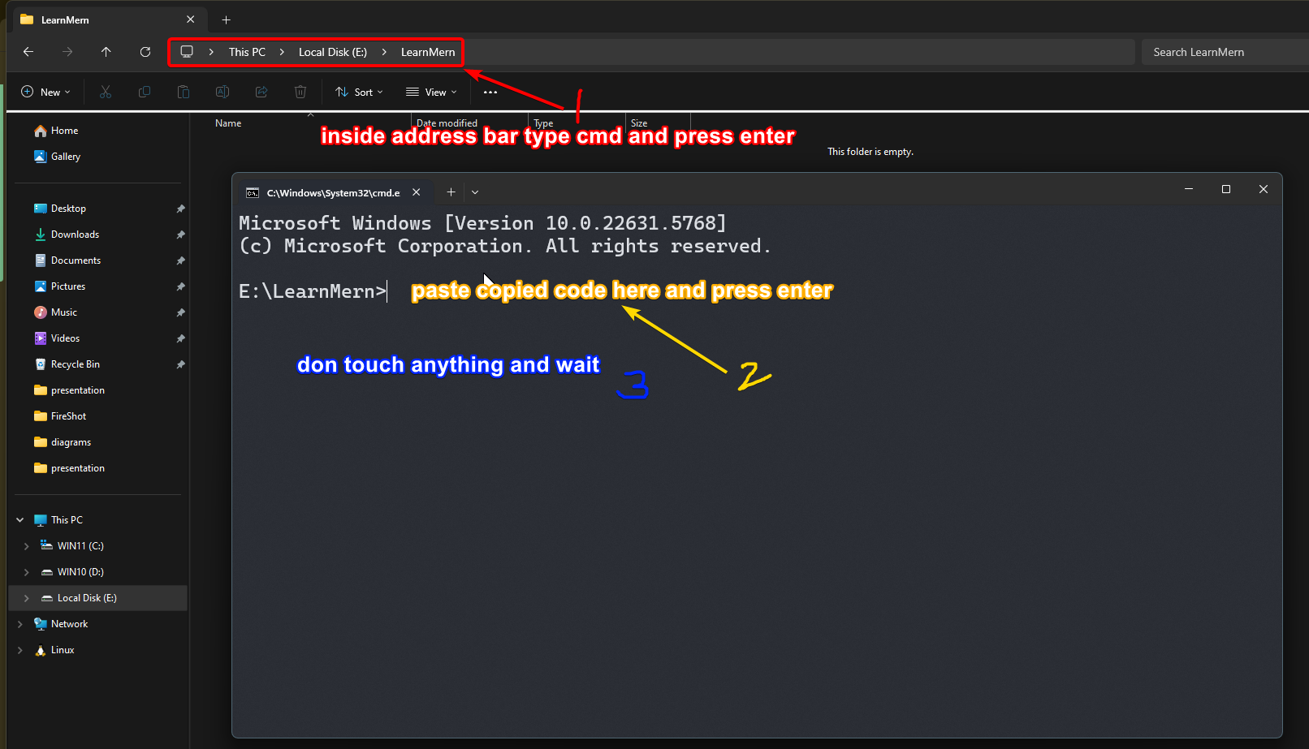

Slide 23
My custom code will automatically set both backend and frontend folder setup for you
2 cmd windows will appear and they will run backend and frontend
Dont do anything, just wait until your browser opens with a react logo page and

Slide 24
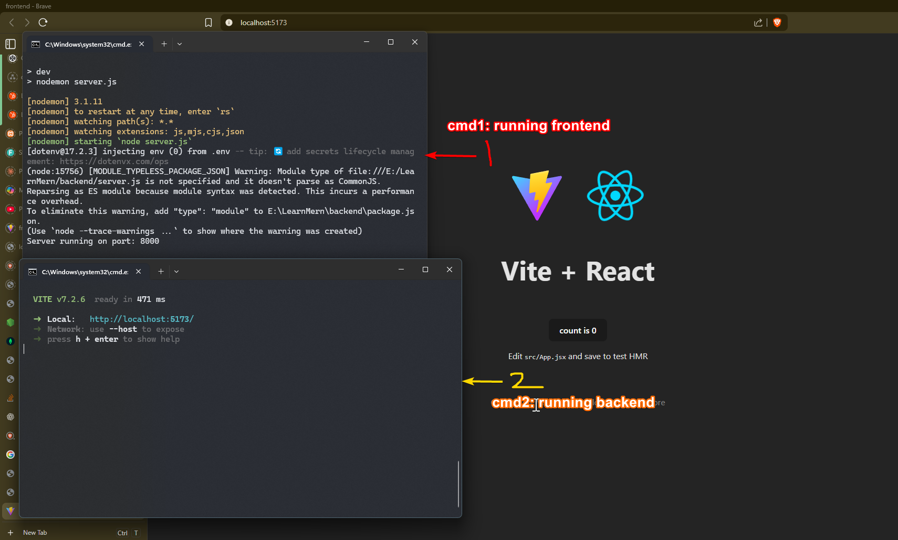

Slide 25
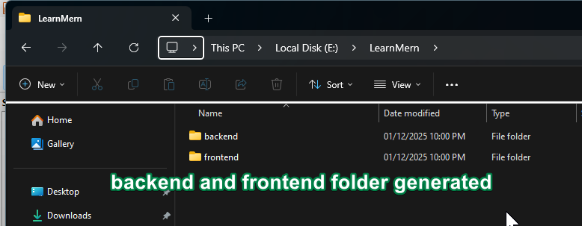

Slide 26

Running Backend and Frontend Servers
Run the backend server with npm run dev --prefix backend and the frontend React app with npm run dev --prefix frontend in separate Command Prompts from address bar at Z:\LearnMern. The backend typically runs on http://localhost:8000 and the frontend on http://localhost:5173. This setup supports live reloading to speed up development.
↓

Slide 27
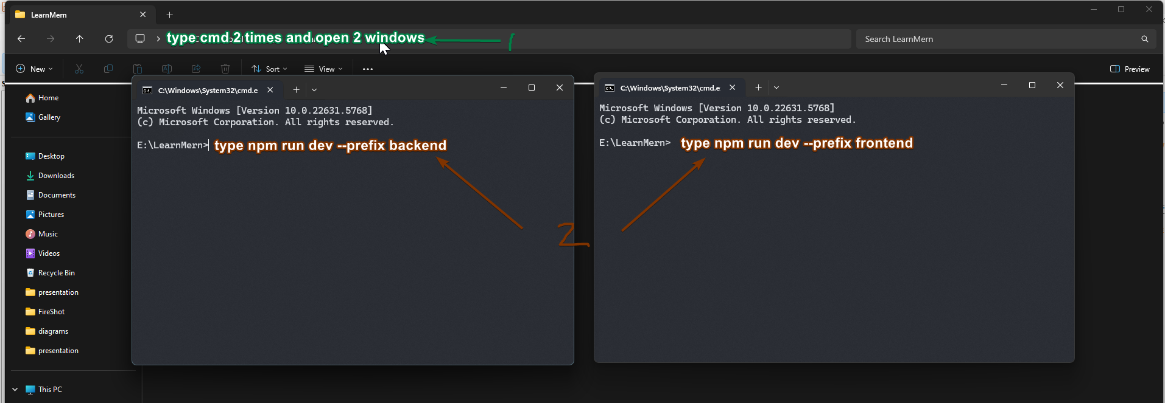
How to run the project next time

Slide 28
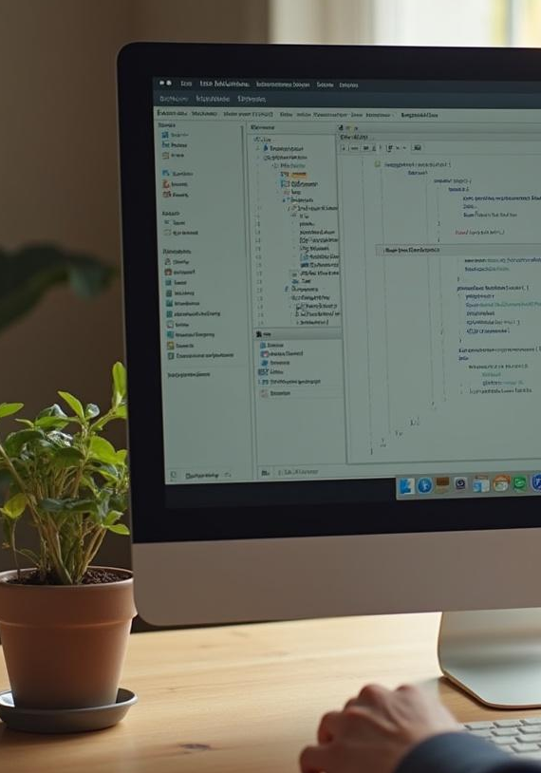
MongoDB Compass: Database Setup
MongoDB Compass lets you visually manage your database. Connect to the local server, create a database named learnMERN, and a students collection. Add student records manually through the UI in JSON format. This helps you understand document-based data storage compared to traditional relational databases.
↓

Slide 29
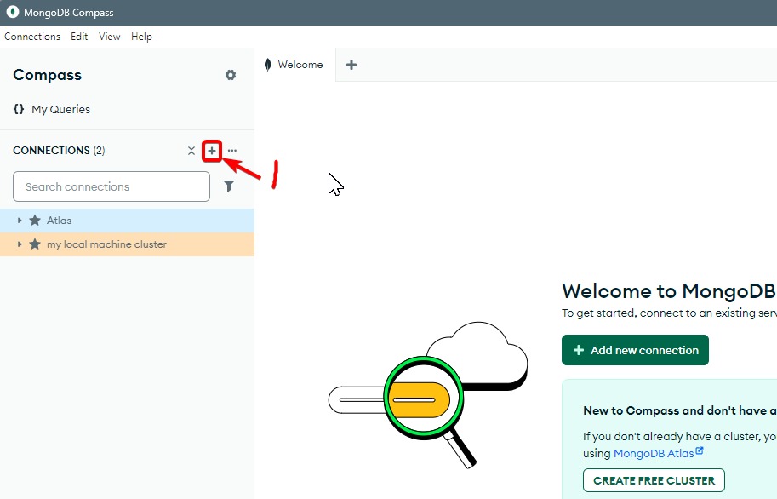

Slide 30
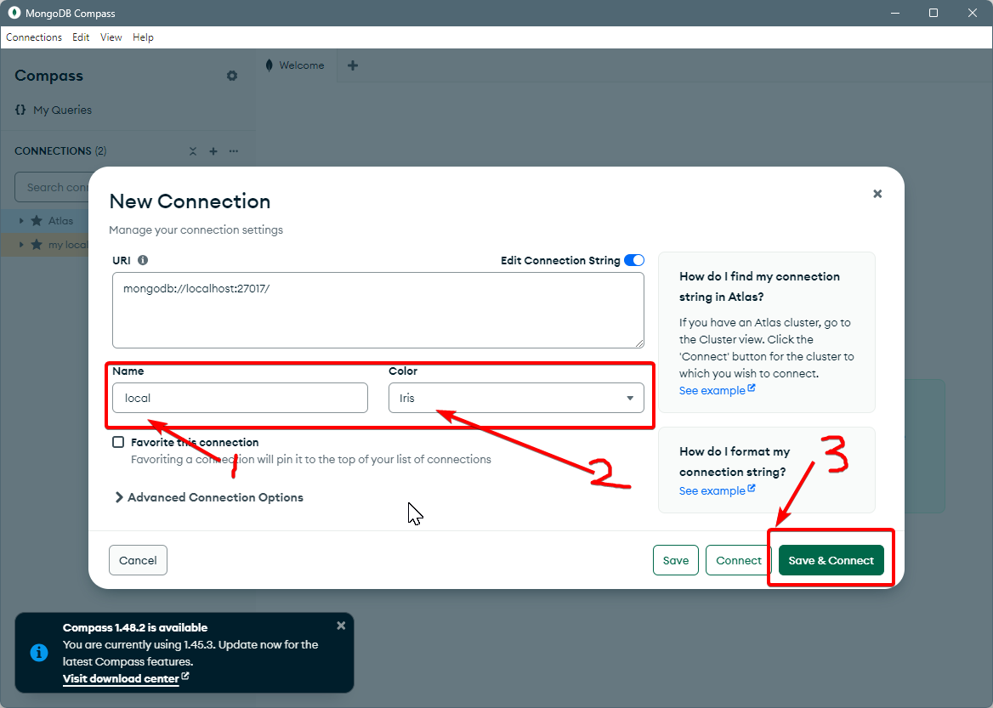

Slide 31
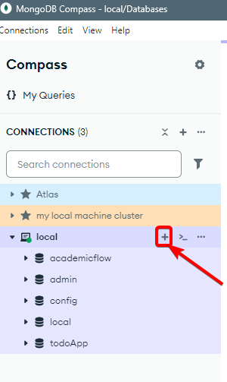

Slide 32
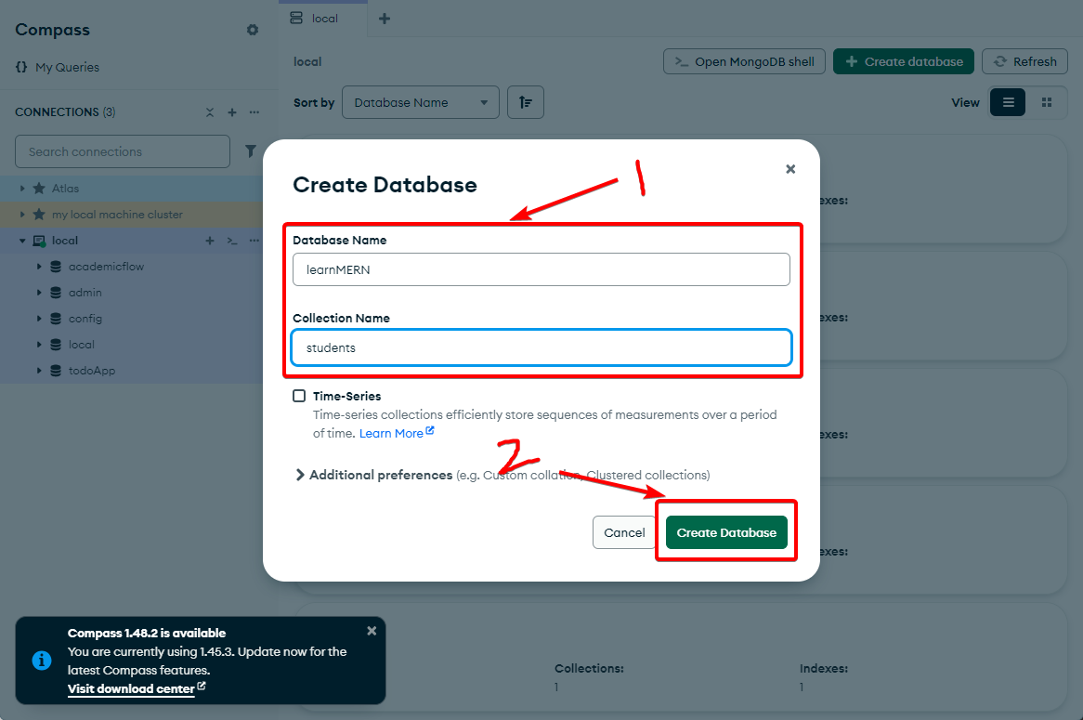

Slide 33
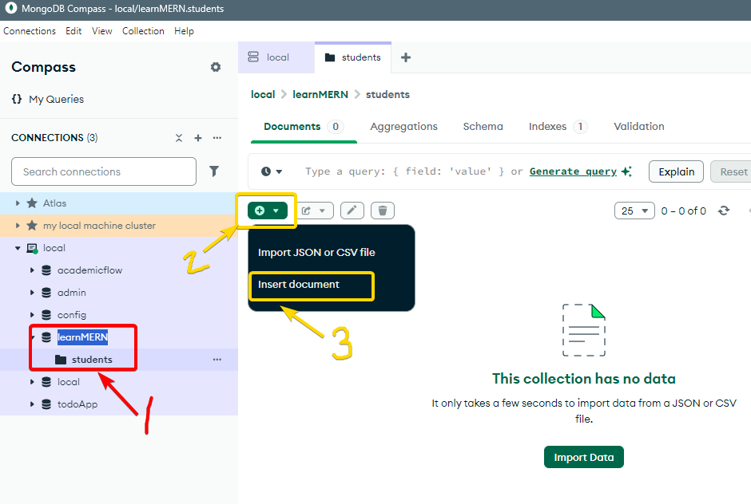

Slide 34
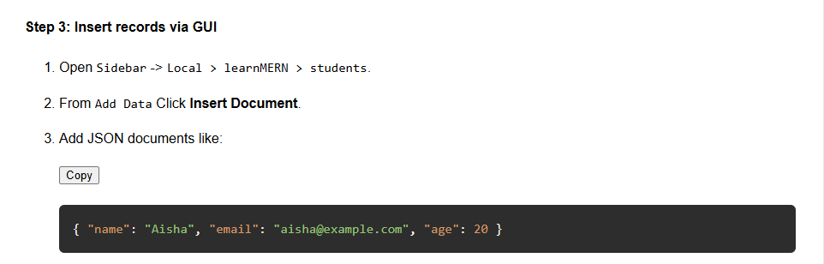
Copy code from chapter 4 step 3 from my site

Slide 35
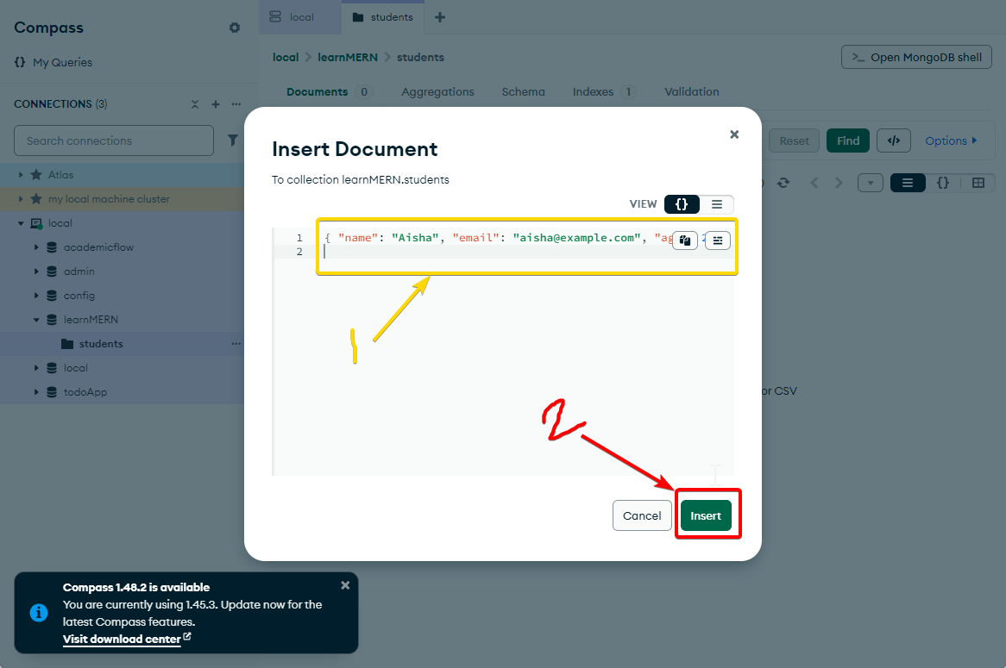

Slide 36
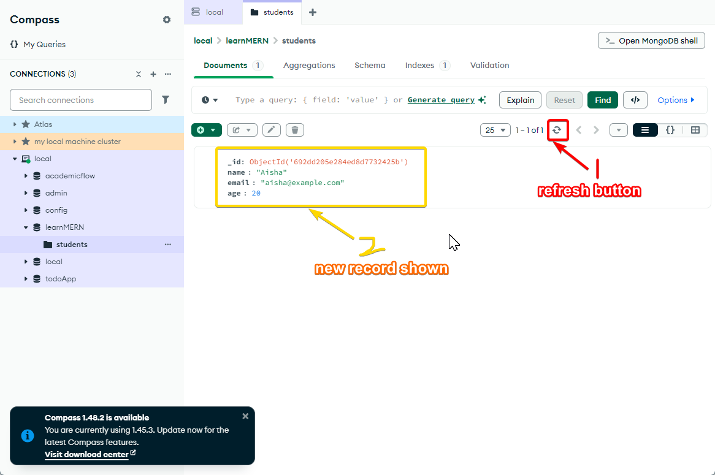

Slide 37
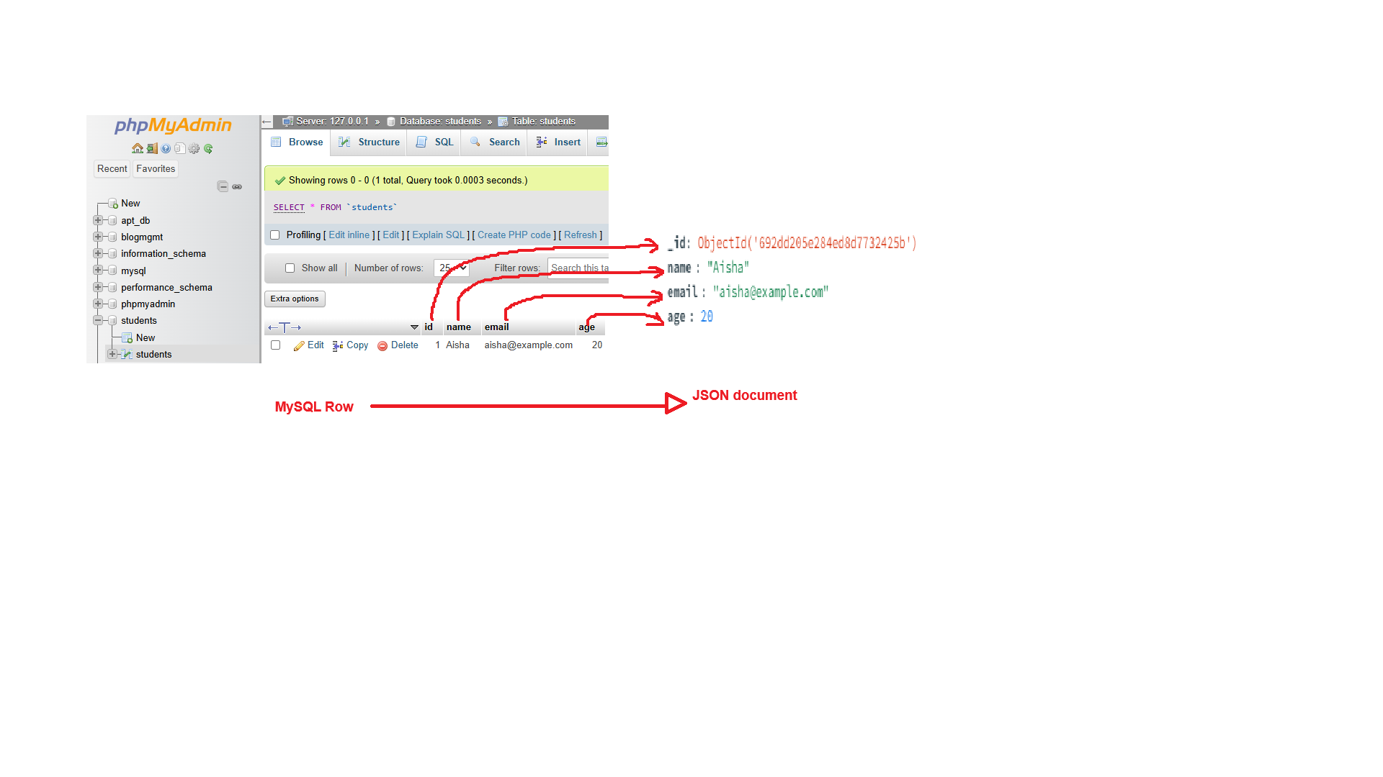

Slide 38
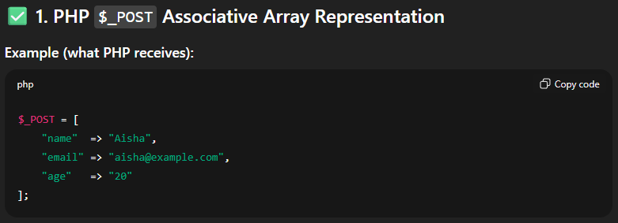
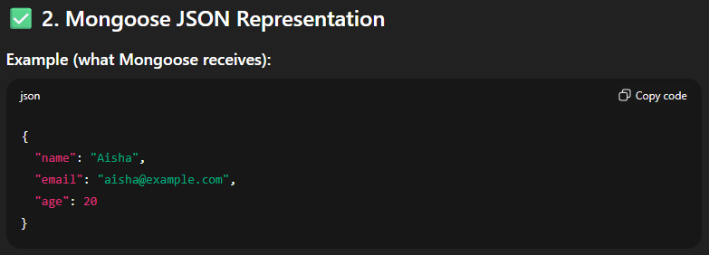
PHP
Mongoose

Slide 39
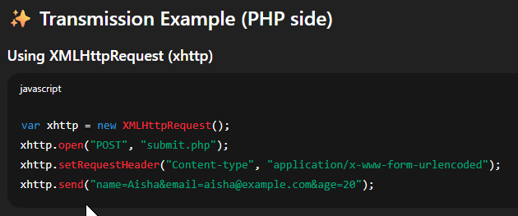
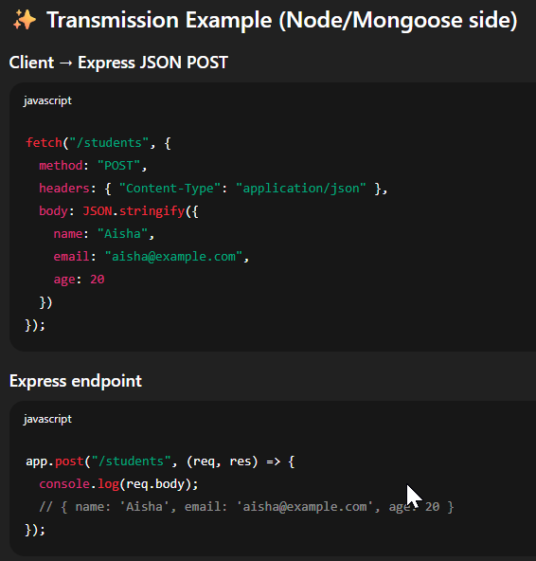

Slide 40

MySQL to Mongo Term Correlation
MySQL Rows → MongoDB JSON Documents
MySQL Table → MongoDB Collection
MySQL Database → MongoDB Database
MySQL Table Structure → MongoDB Schema
↓

Slide 41
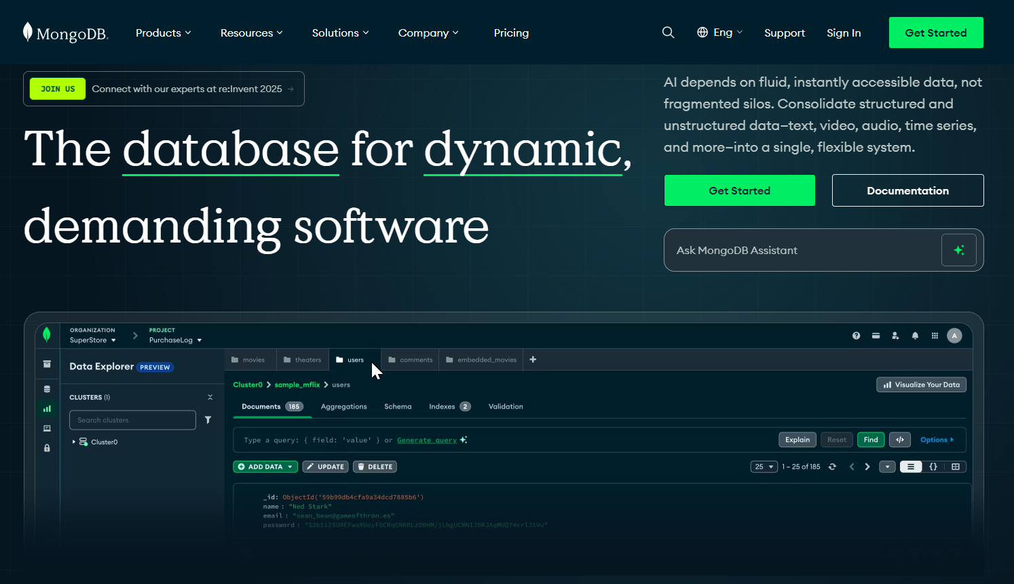

Slide 42
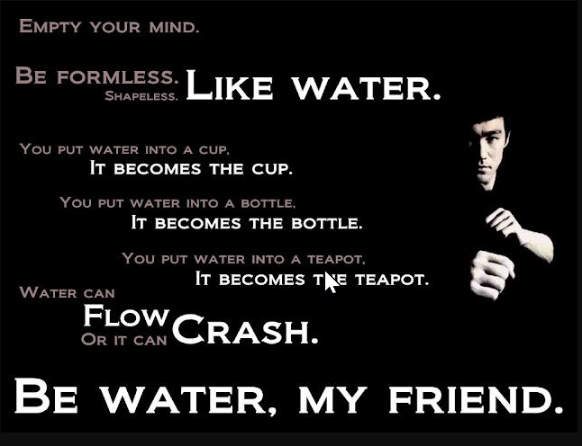

Slide 43
Connecting Mongo DB and Compass to Express Backend
→
Build your backend APIs by defining a Student schema with Mongoose for enforced structure. Unlike Traditional DB where a we define a table structure at table creation before inserting records. Mongo DB does not define any structure. This is because it is schema less and flexible.

Slide 44
Connecting Mongo DB and Compass to Express Backend
→
This however means we have to tell the express backend in what format we are receiving data from mongodb because each row can store any type of data or any amount of fields. In the case of mysql we already define a permanent structure at table creation so php backend will recognise structure automatically

Slide 45
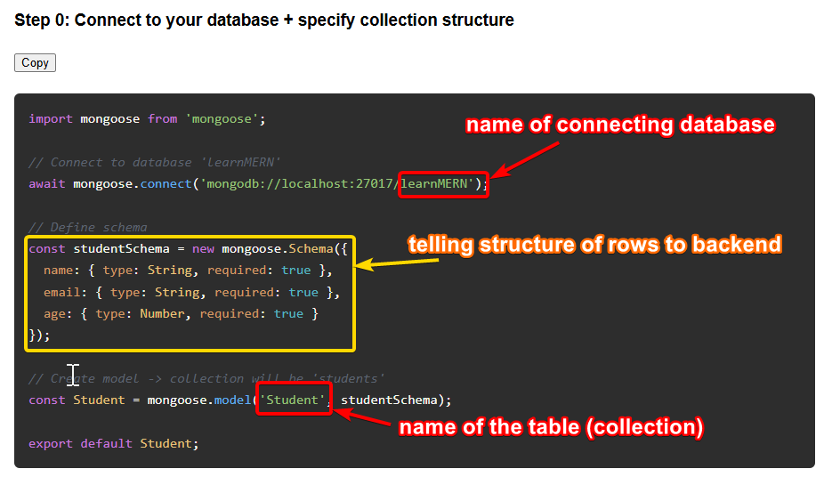
Chapter 5 step 0 on my site covers how we can tell express backend the structure of our students collection (table). Copy and paste the code in backend\server.js !! without replacing !! below pre-existing code

Slide 46
Creating APIs with Express and Mongoose
→
Implement CRUD operations using Express and Mongoose with clearly defined routes for reading, creating, updating, and deleting student data. Use Mongoose methods such as find(), create(), findByIdAndUpdate(), and findByIdAndDelete() for database interactions. Test endpoints with curl or Postman, and verify database updates visually with MongoDB Compass to ensure accuracy and consistency in your application.

Slide 47
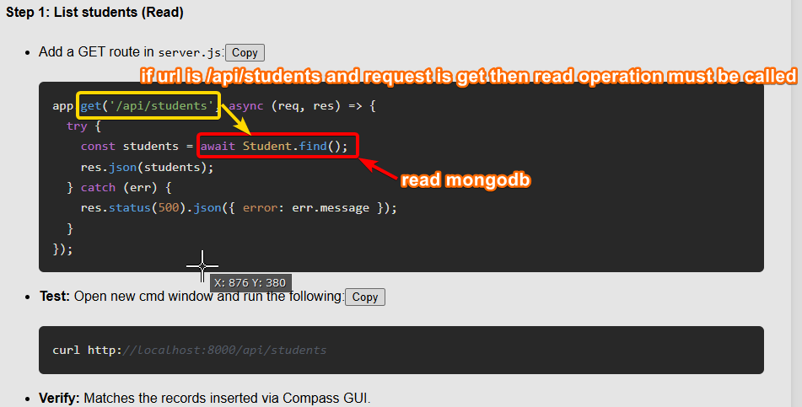

Slide 48
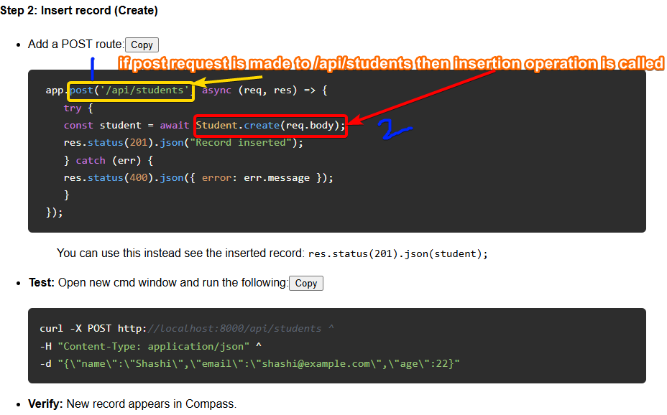

Slide 49
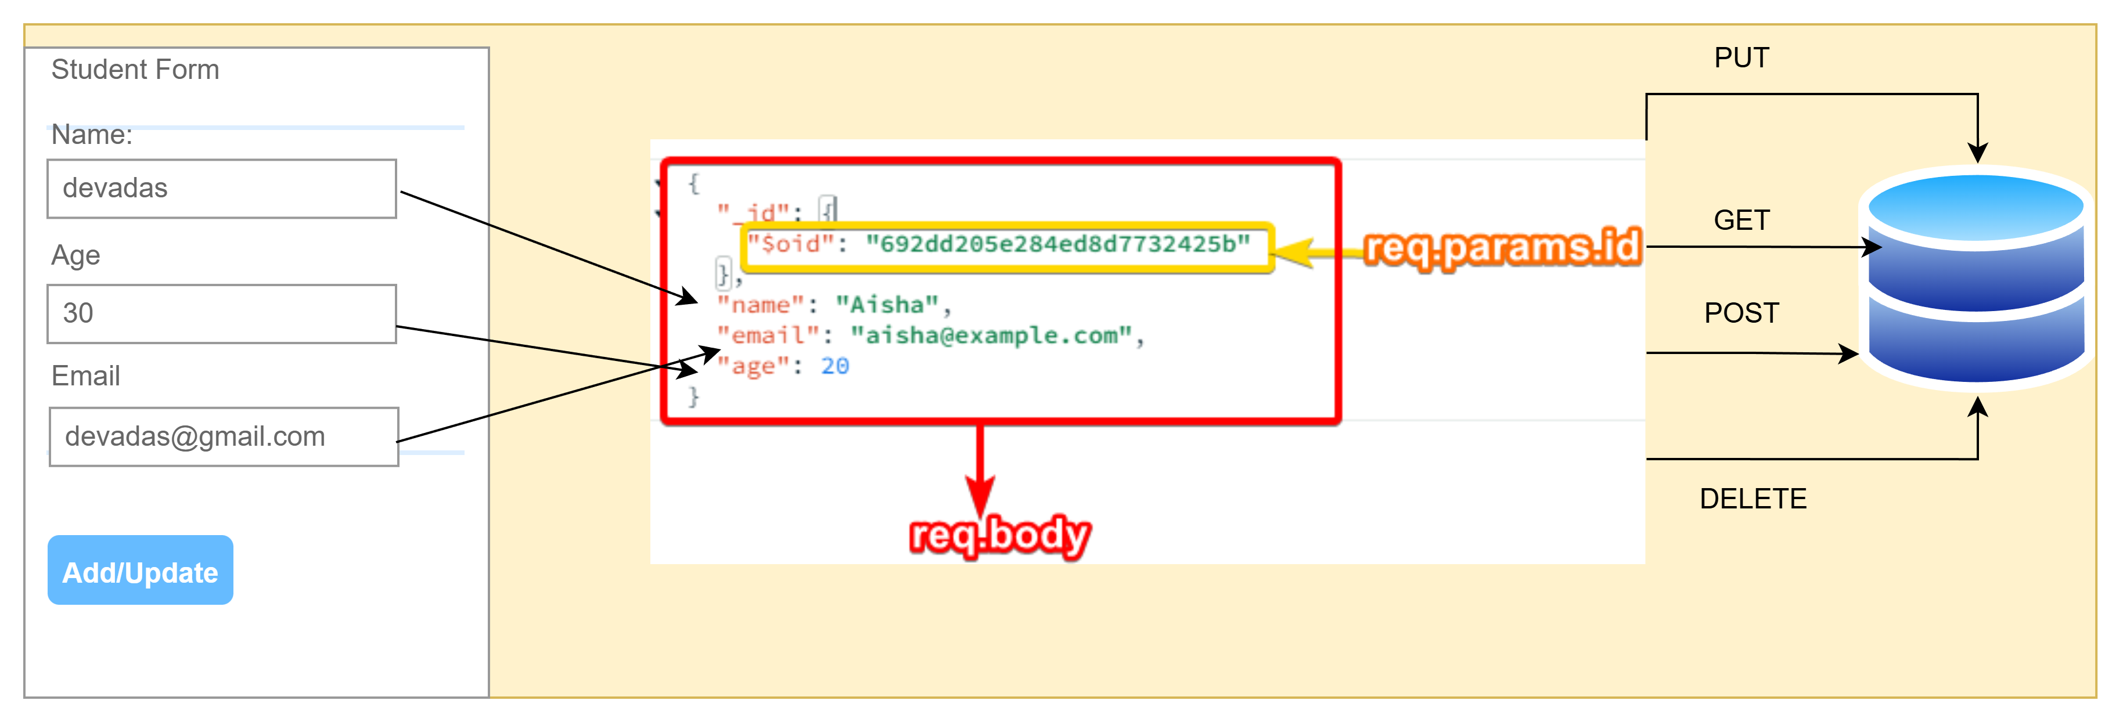

Slide 50
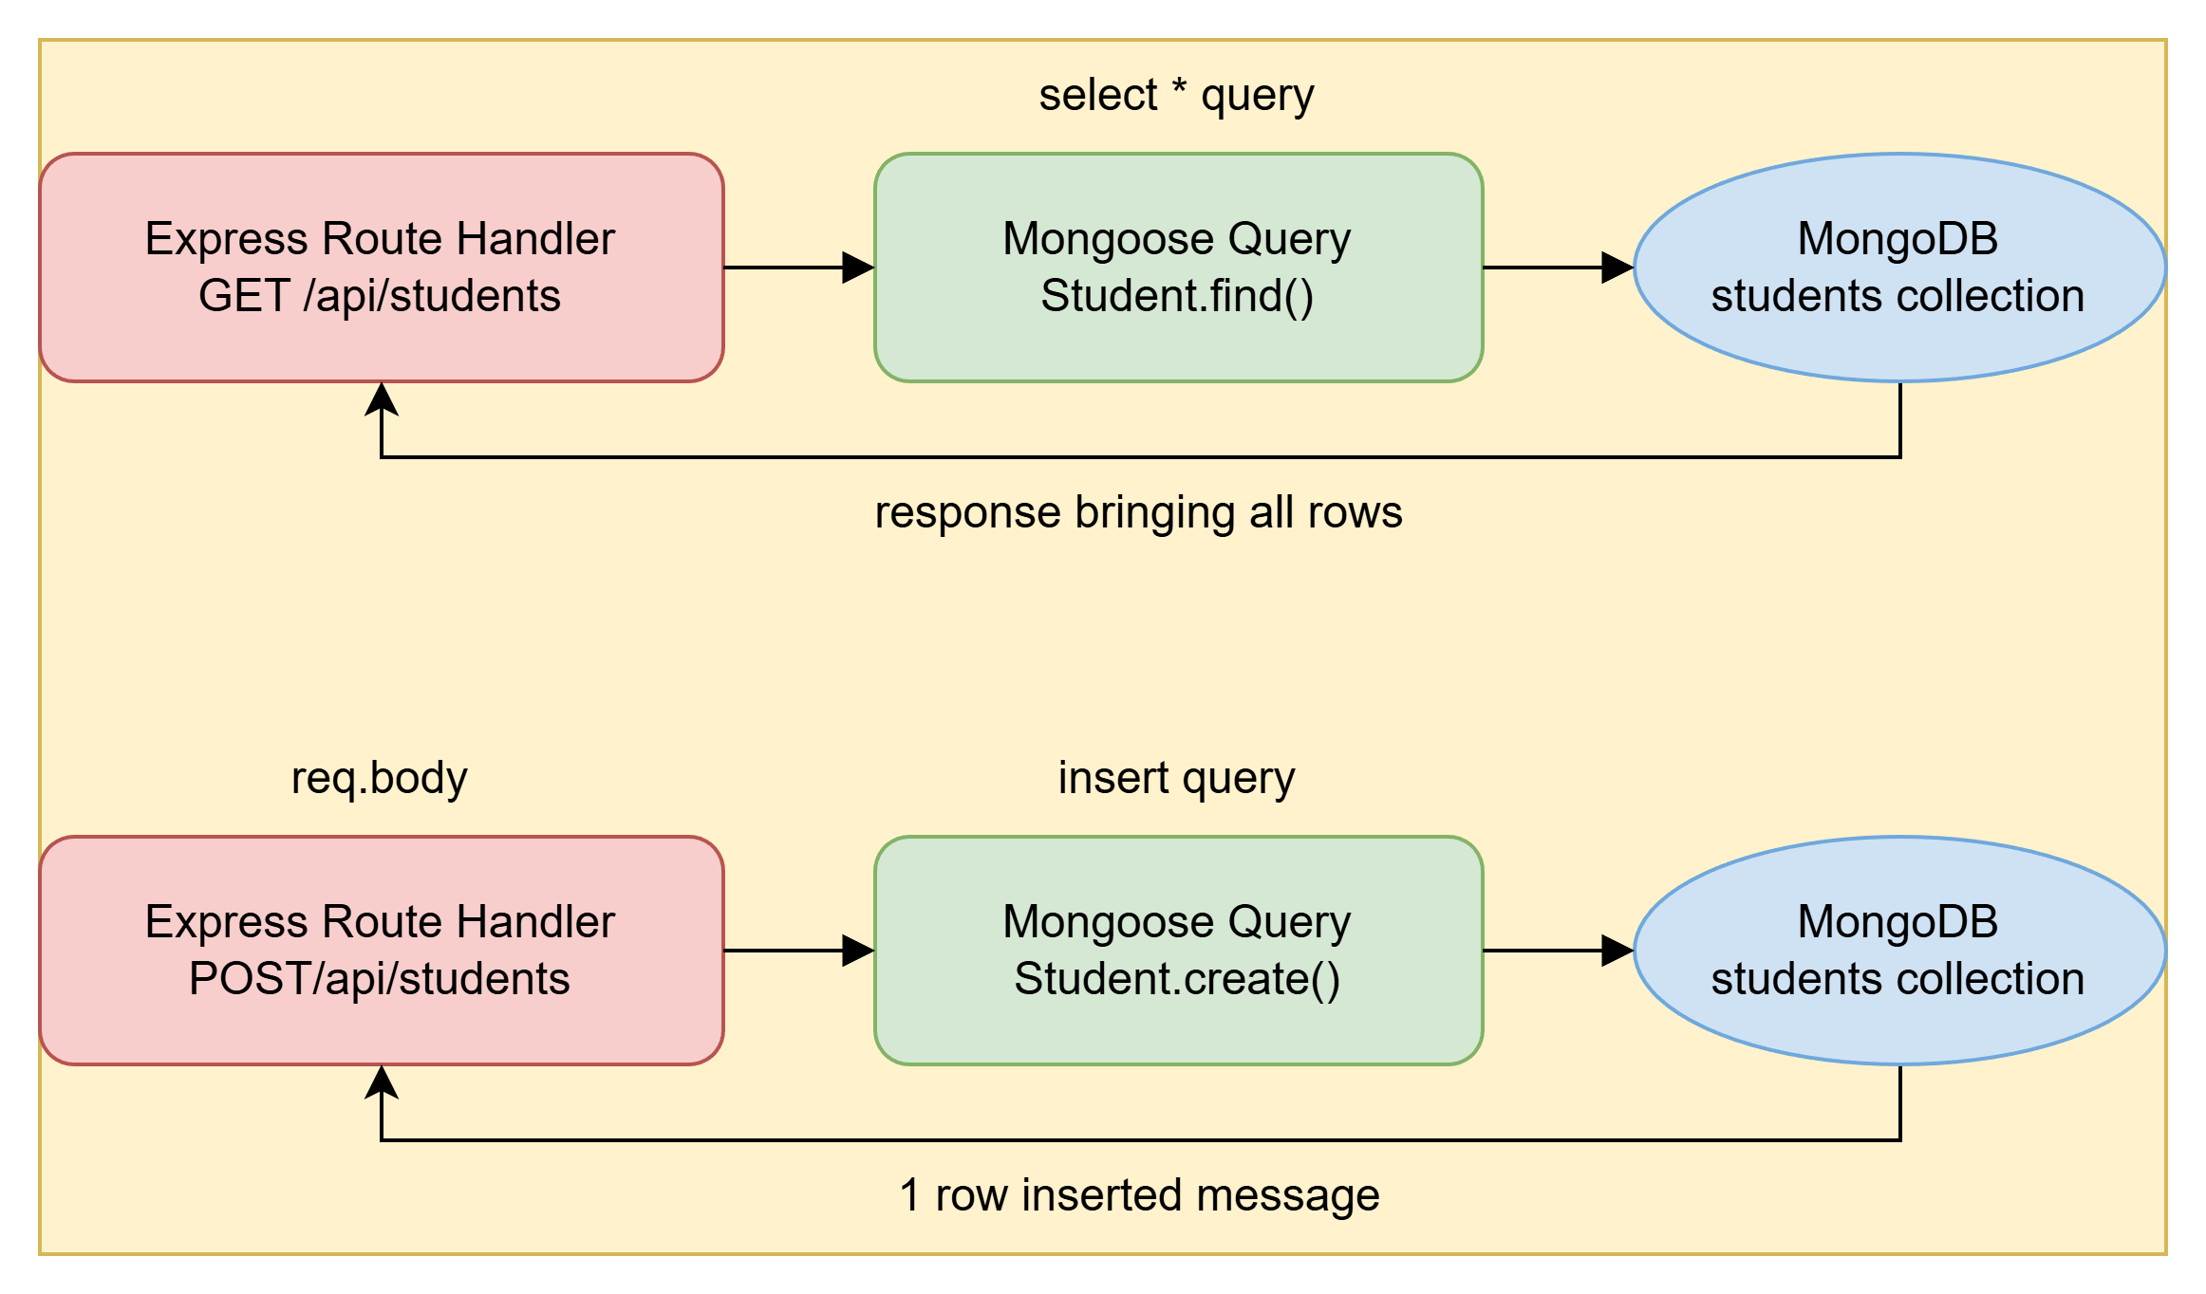

Slide 51
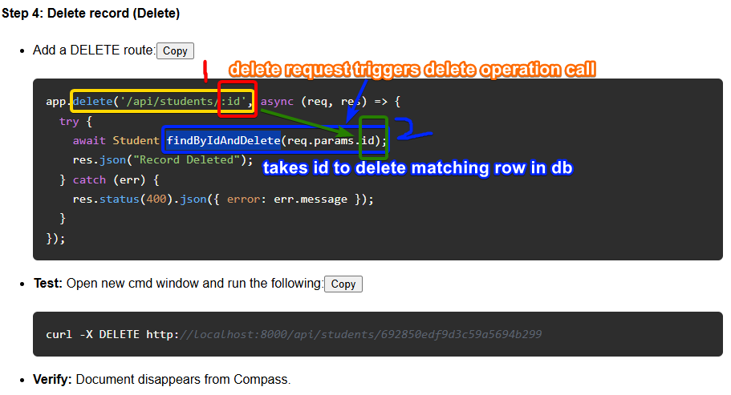

Slide 52
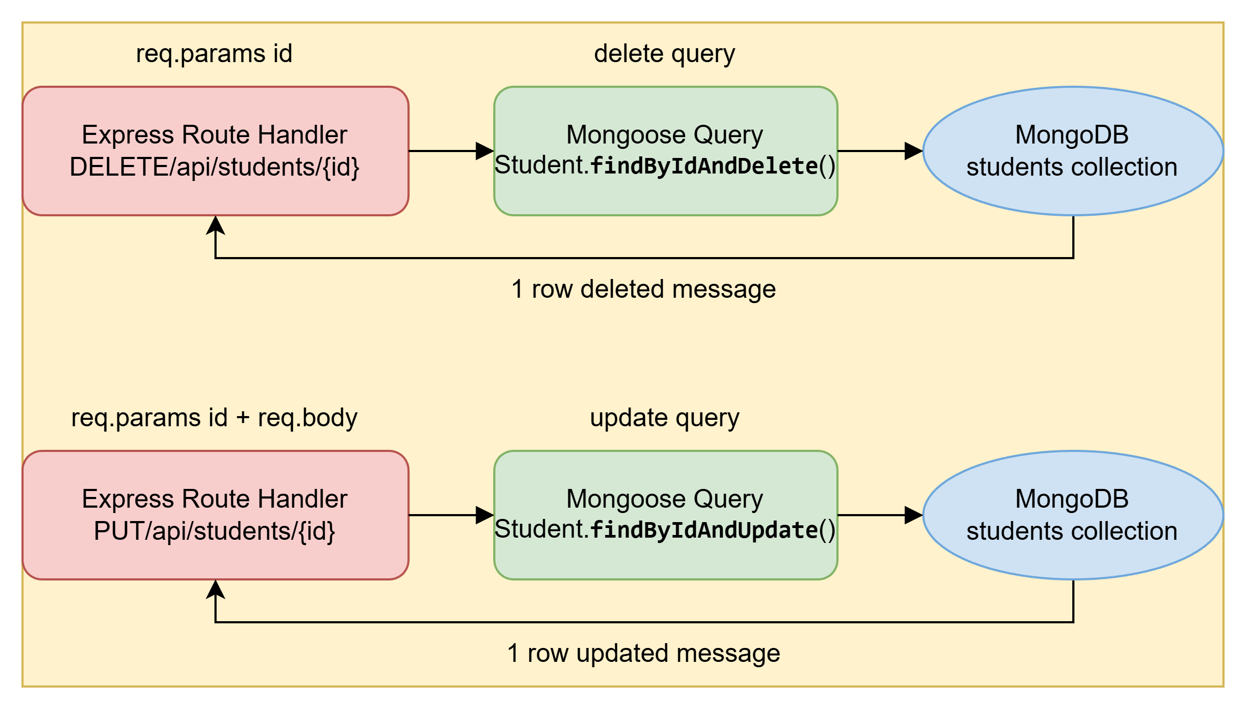

Slide 53

Frontend Development with React
Copy code from chapter 6 step 1 into frontend\App.js to perform read operation at frontend and print list of students
↓

Slide 54
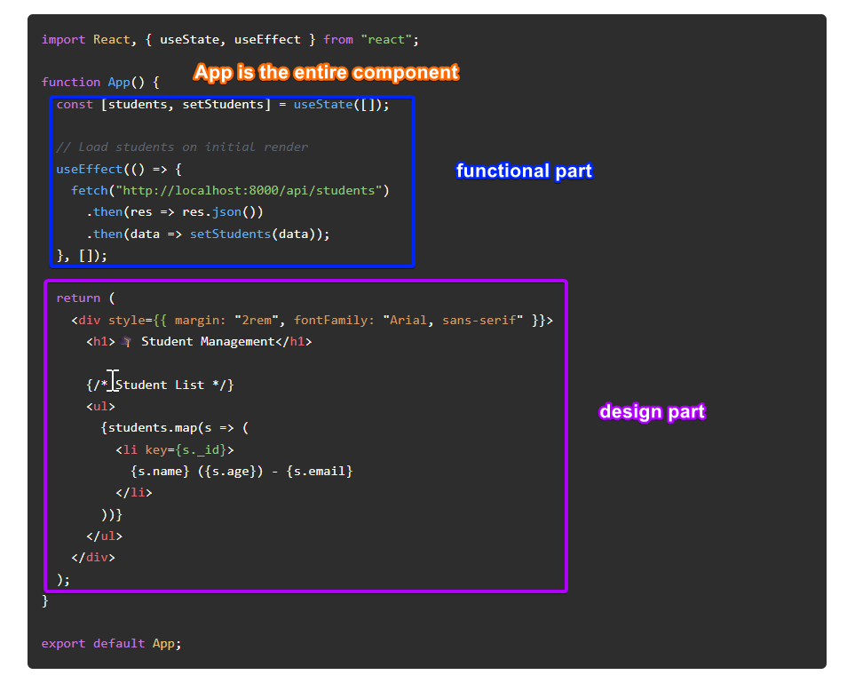

Slide 55

Fetching and Showing Student Data
Use React hooks like useState to store students and useEffect to fetch data on component mount. Fetch the list of students from the backend API and render them dynamically in a list. This initiates your React frontend connection to the backend and displays real-time student data on the UI with easy-to-understand state management techniques.
↓

Slide 56
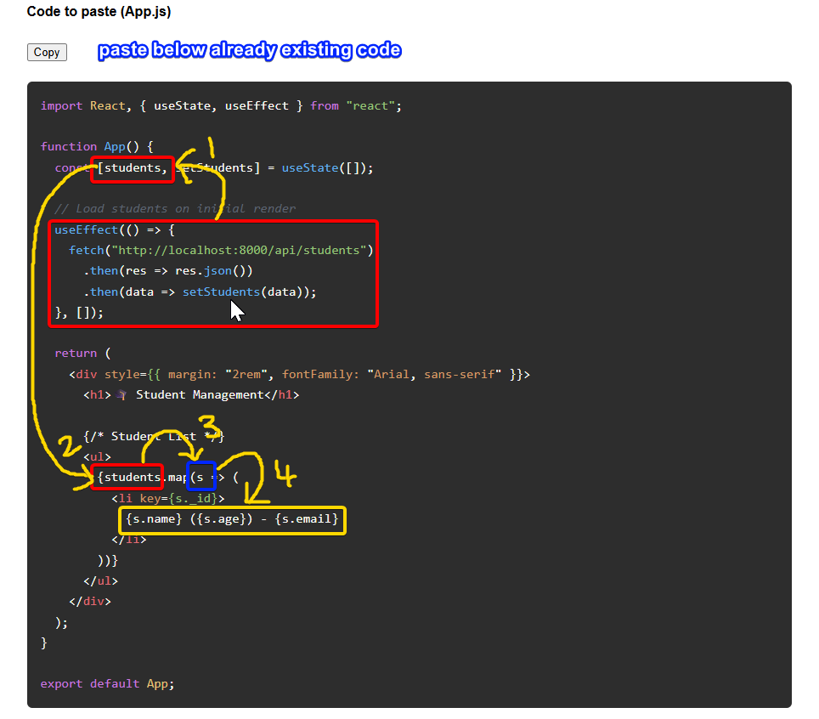

Slide 57
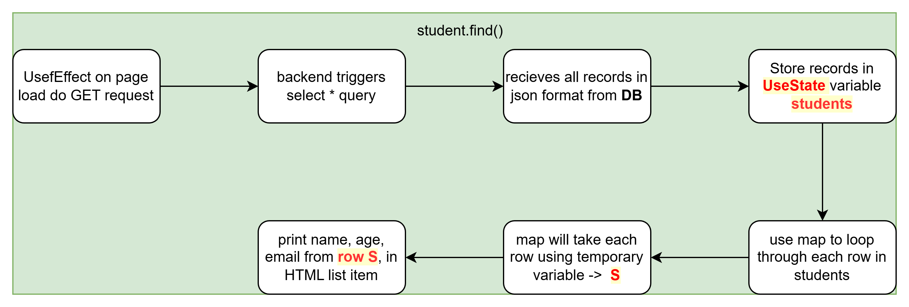

Slide 58
Deleting Records
→
Pass id through a button and make DELETE request

Slide 59
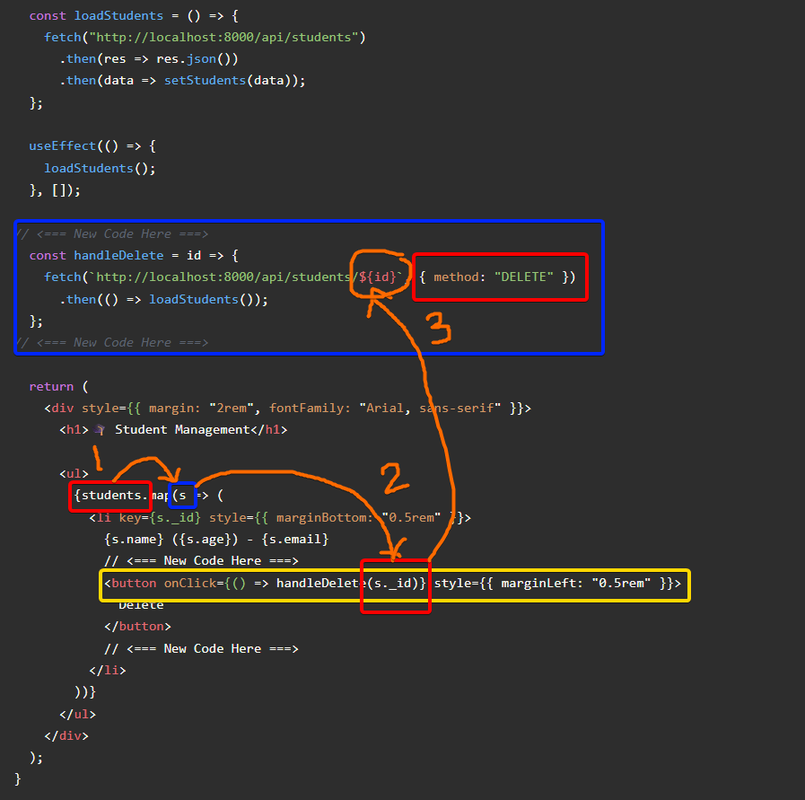

Slide 60
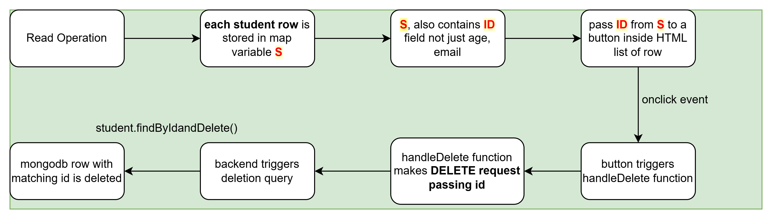

Slide 61
Creating and Updating Records
→
Add a controlled form to handle new student creation using useState for form inputs and track current editingID. Submitting the form triggers a POST request to the backend if editingID is null otherwise PUT request, followed by refreshing the student list. Implement update functionality with buttons that fill form inputs with pre existing data. After each mutation, reload the list to keep the UI synced with the backend.

Slide 62
Editing and Updating Records
→
Enable edit mode by storing the current records ID to toggle between create and update operations. Prefill the form fields with selected student data, modifying the submit button text accordingly. On form submission, send PUT requests to update existing records, then refresh the student list to show the latest data and maintain a seamless user experience.

Slide 63
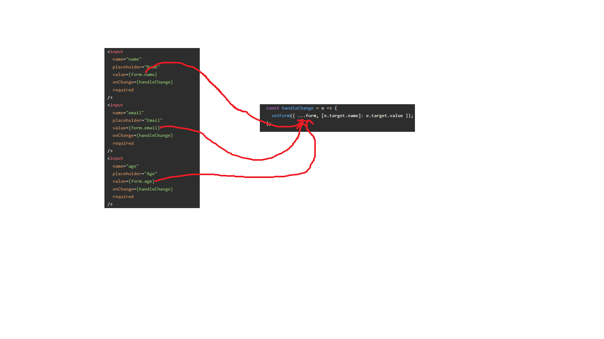
Insertion pt 1

Slide 64
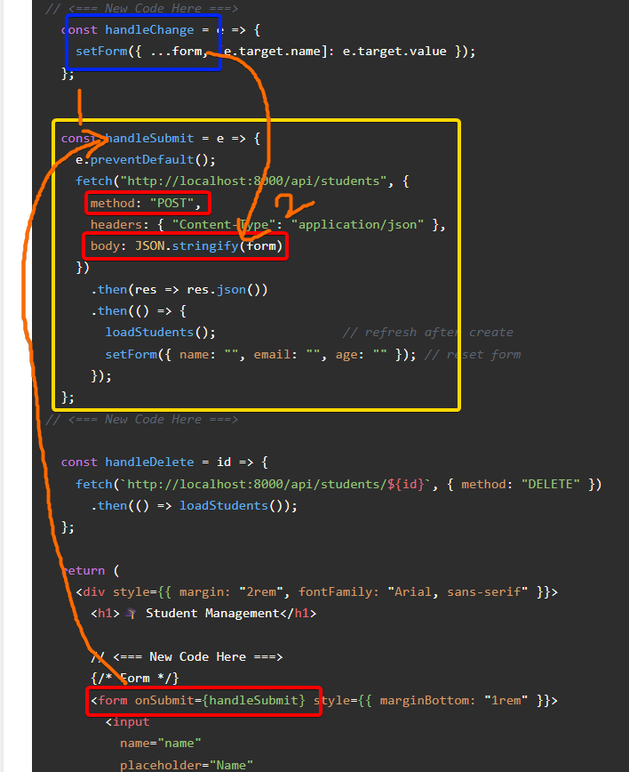
Insertion pt 2

Slide 65
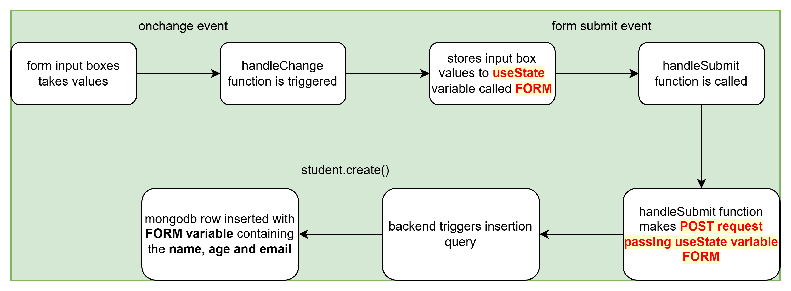

Slide 66
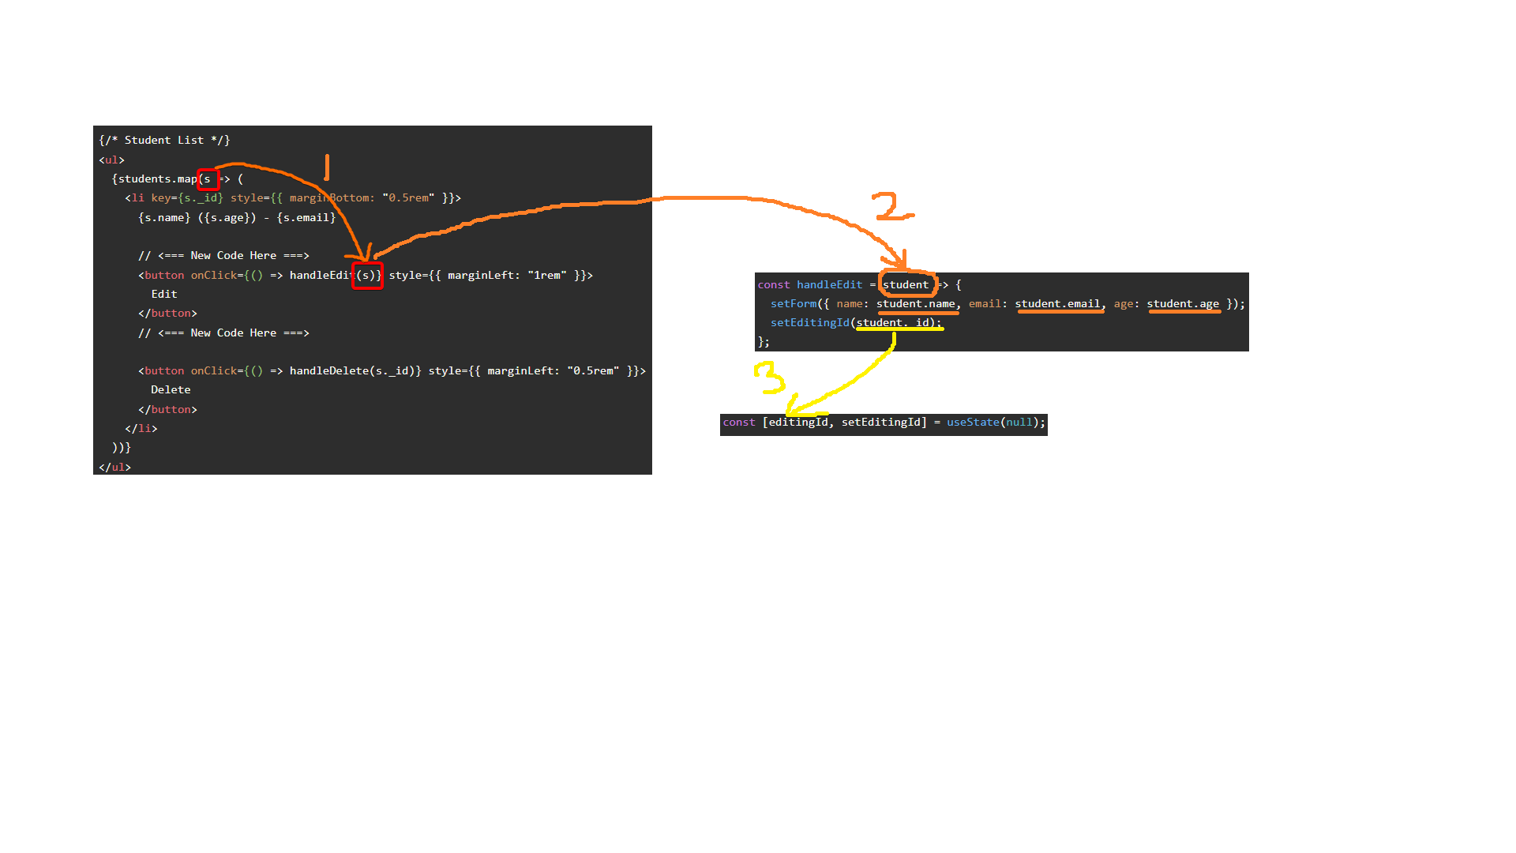
Update pt 1 (showing editing record data in form input boxes and set value to editingID)

Slide 67
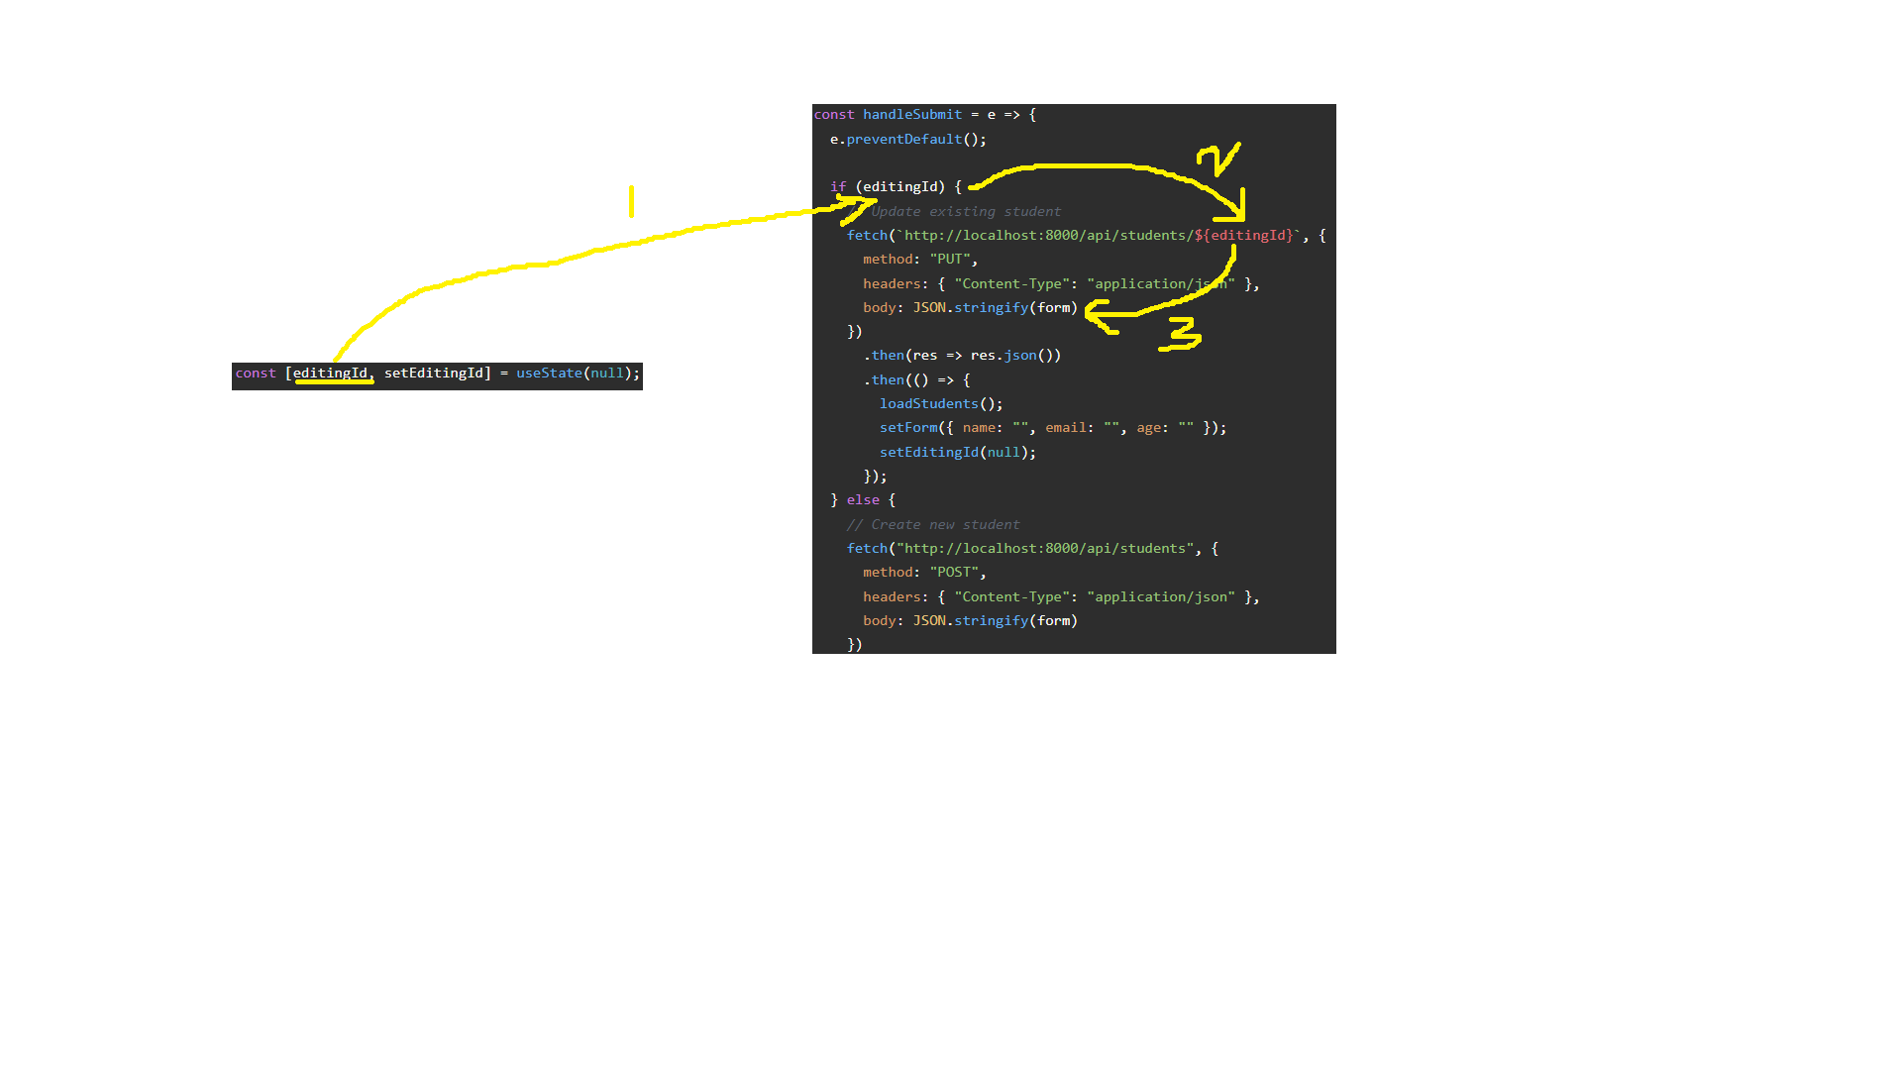
Update pt 2 (triggering PUT request if editingID has value)

Slide 68


Slide 69

Managing Environment Configuration
Organize environment variables in .env files using dotenv to keep sensitive configurations out of code. Ensure correct paths and ports for backend and frontend are defined consistently to avoid conflicts. Proper environment management facilitates smooth transitions between development, testing, and production setups.
↓

Slide 70
Streamlining Development Workflow
→
Utilize tools like nodemon for automatic backend server restarts and Vite for fast React frontend builds. Run backend and frontend servers concurrently in separate command prompts for efficient development. Constantly reload data after CRUD operations to keep UI and database in sync, improving productivity and minimizing errors.

Slide 71

Conclusions
Building a MERN stack app involves setting up a robust backend with Express and Mongoose, managing data using MongoDB, and crafting an interactive React frontend. Understanding environment setup, troubleshooting, and smooth workflows sets the foundation for productive development. Mastering CRUD operations and syncing frontend-backend interactions completes the learning journey toward full-stack JavaScript proficiency.
↓

Slide 72

Thanks!
↓
CREDITS: This presentation template was created by Slidesgo, and includes icons, infographics & images by Freepik

